Slide 1
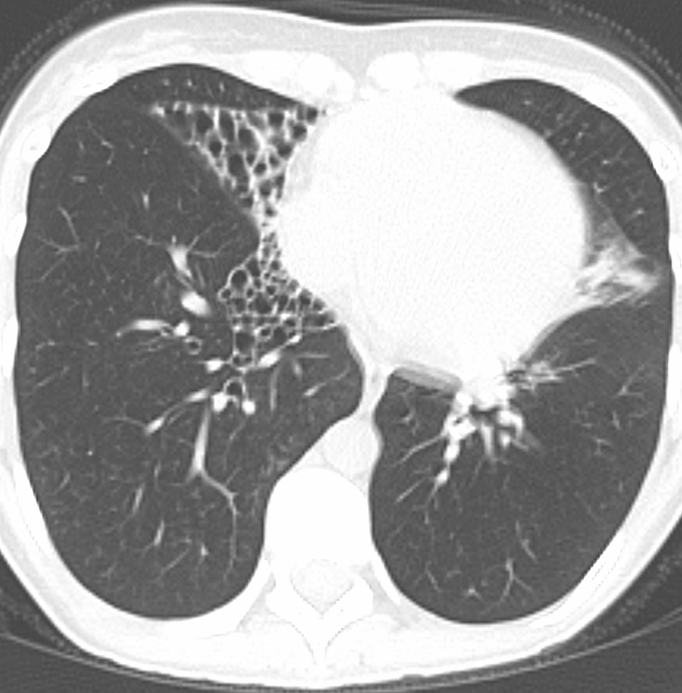
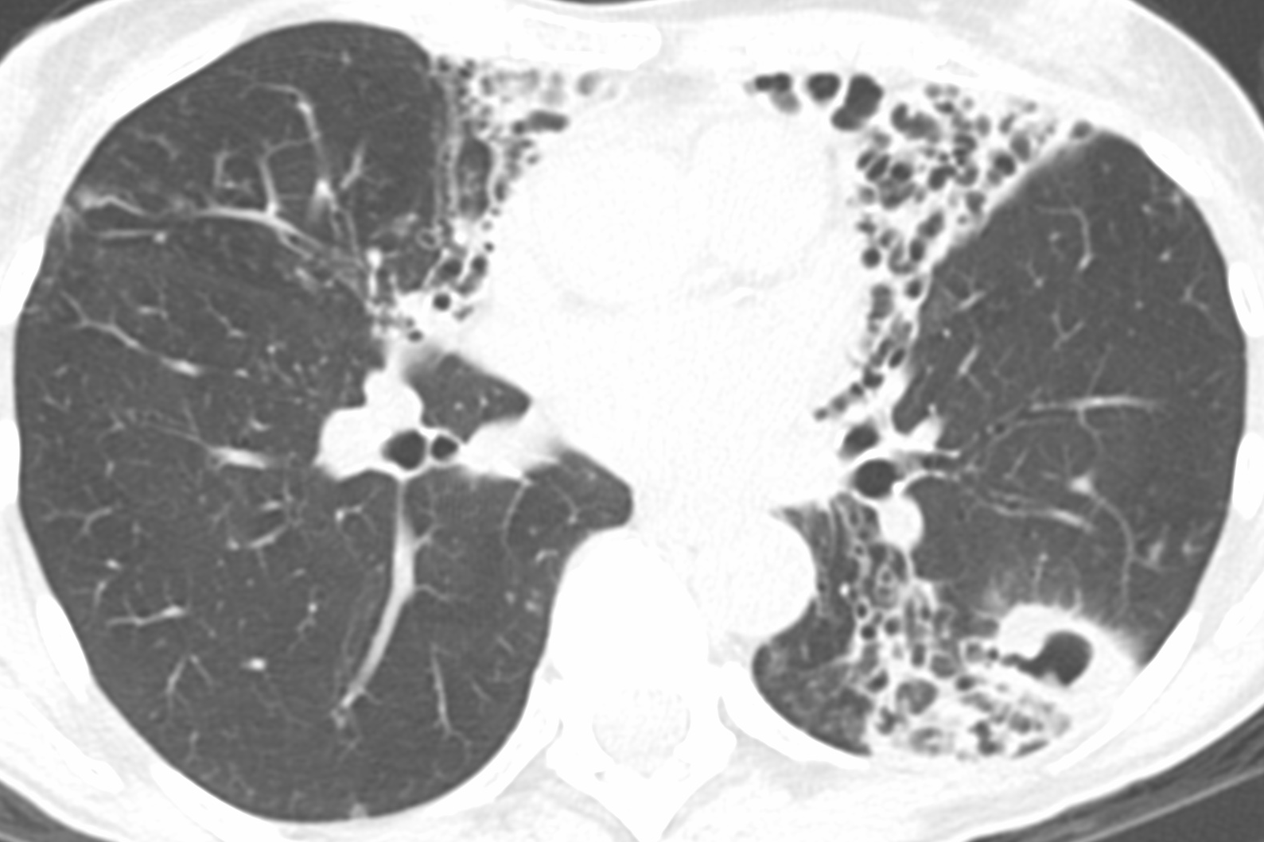
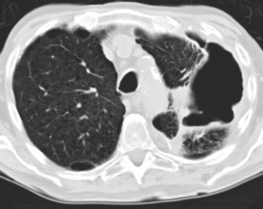
Table 1
Patient characteristics
 | NB (n=108) | NBc (n=36) | Fibrocavitary (n=13) | Unclassified (n=9) | p-value
Age (mean yrs ± SD) | 66.8 ± 10.0 | 65.6 ± 7.2 | 67.5 ± 7.3 | 58.4 ± 14.7 | 0.088
Female sex [n (%)] | 99 (91.7%) | 34 (94.4%) | 11 (84.6%) | 8 (88.9%) | 0.733
NB
NBc
Fibrocavitary disease

Slide 2
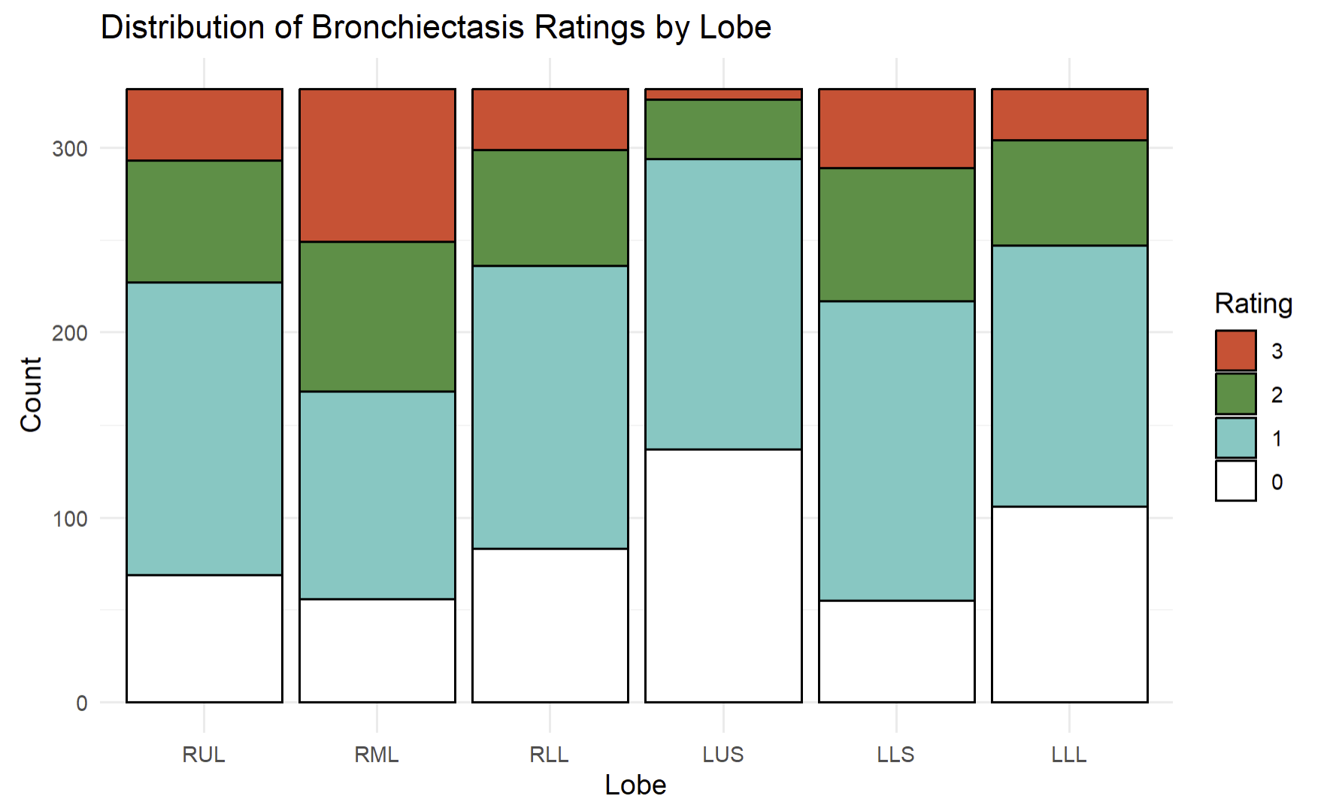
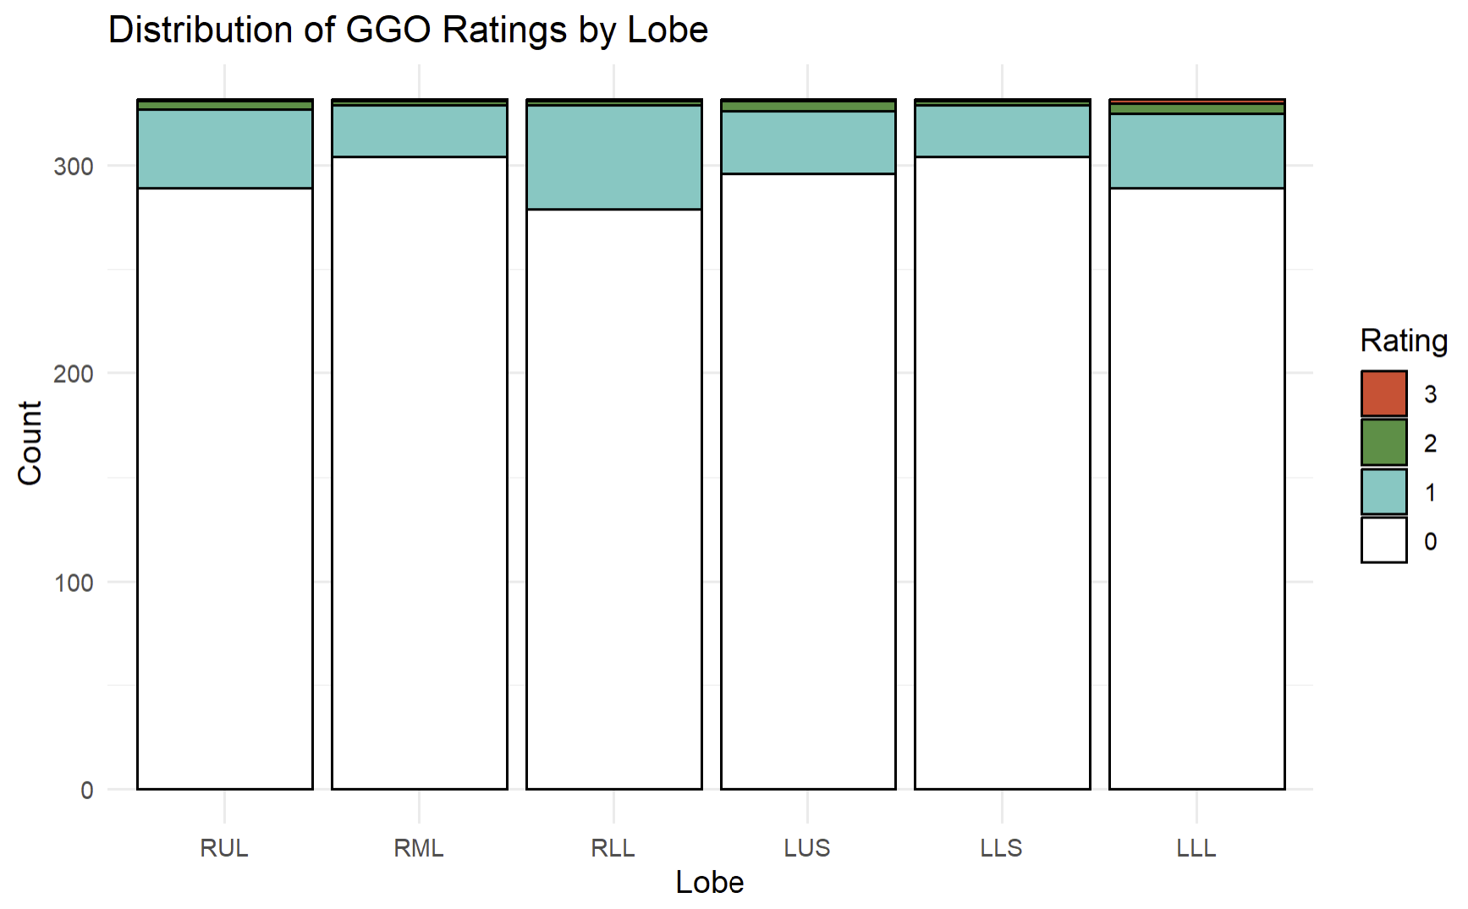

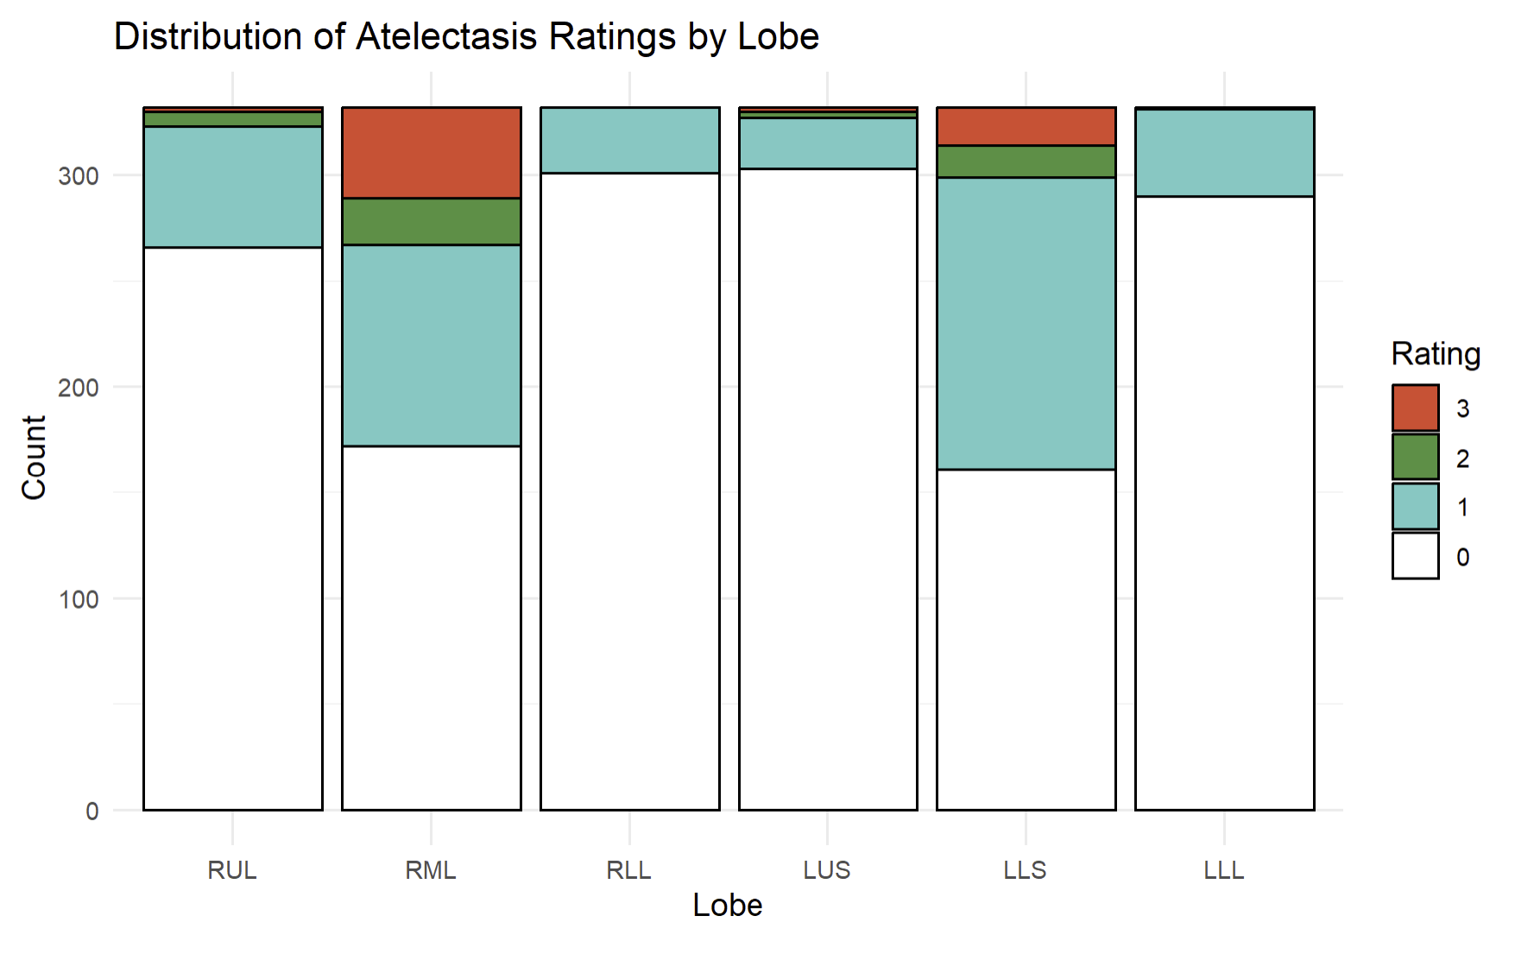
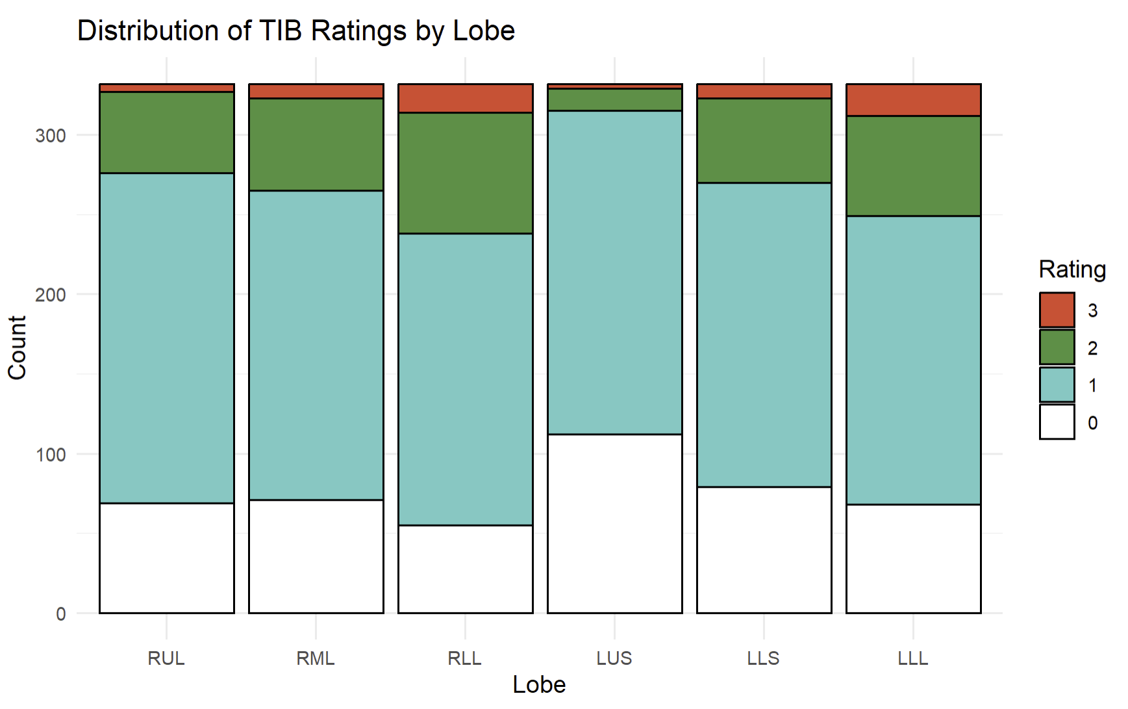
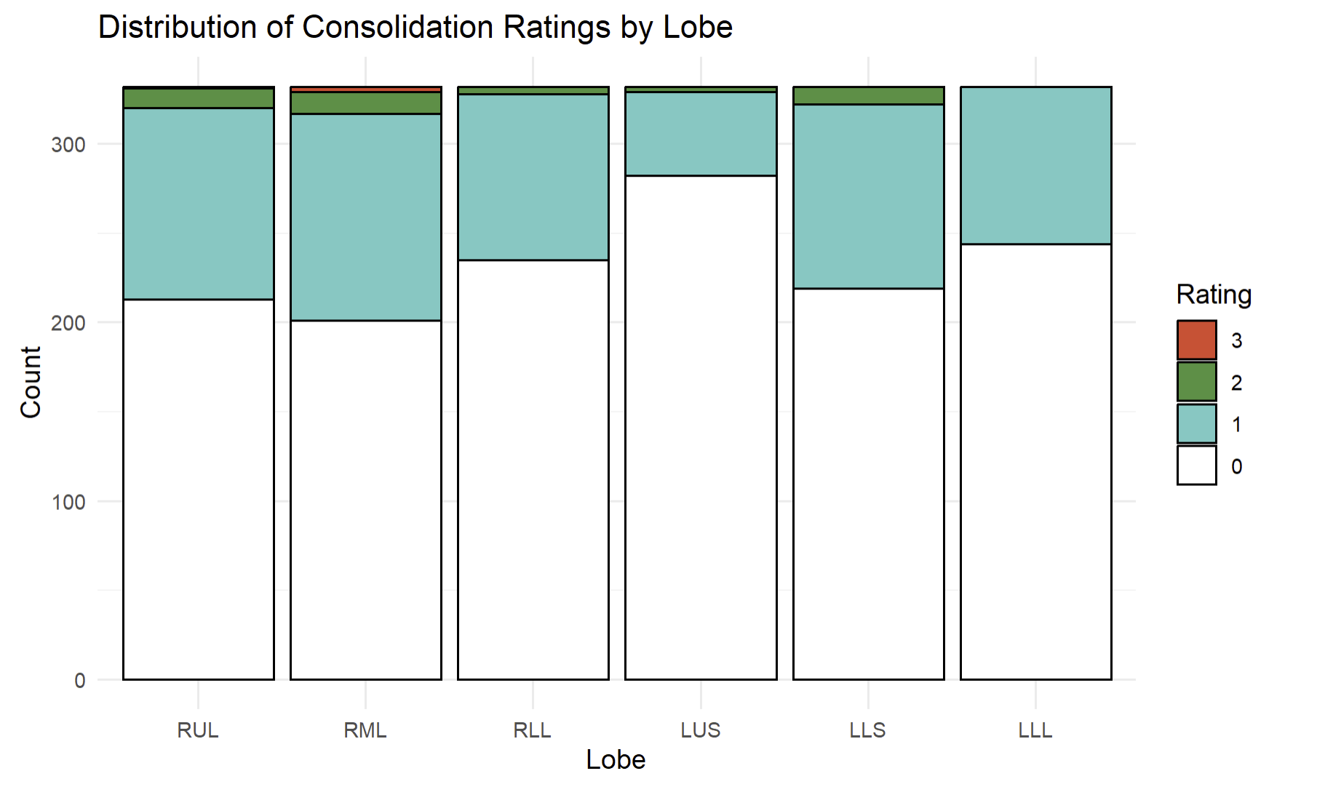
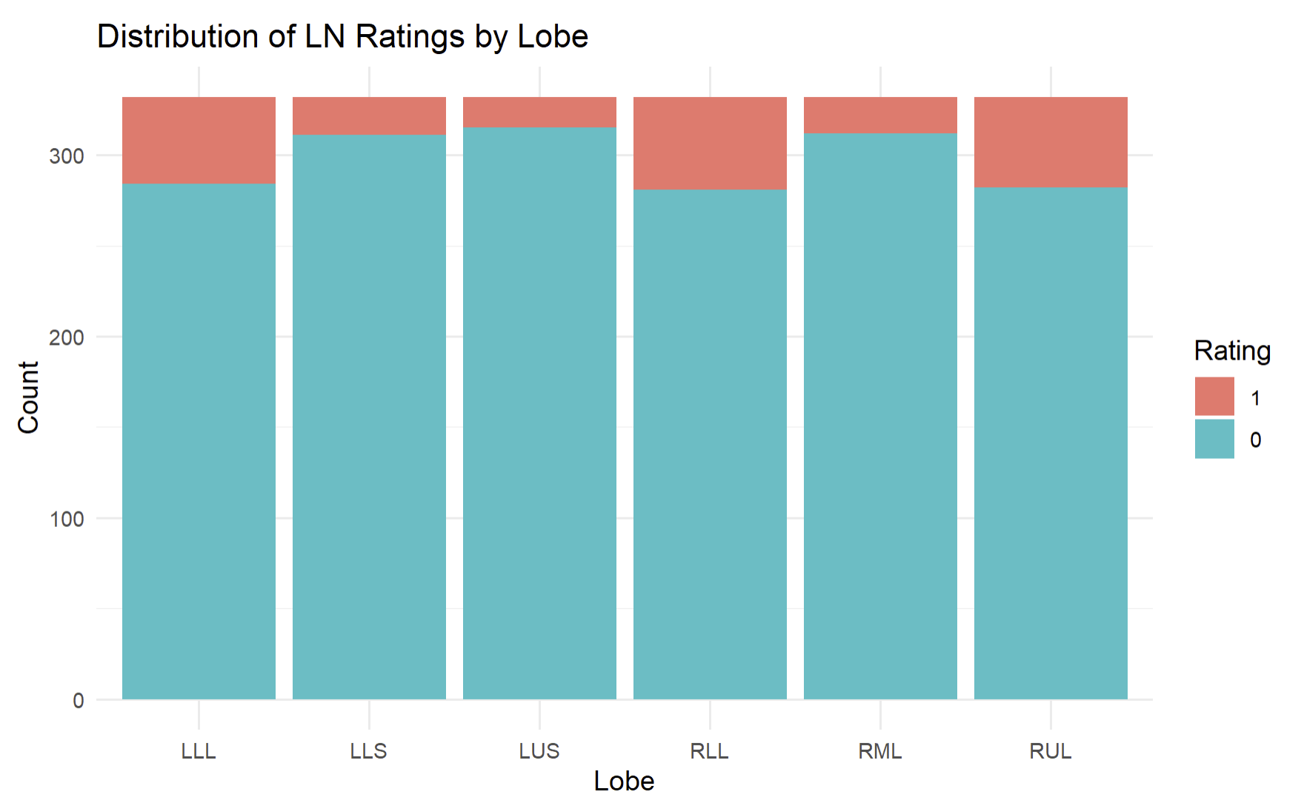
A) Bronchiectasis: RML, Lingu > others (OR 1.76-22.58)
D) GGO: RLL, LLL, RUL > others (OR 2.04-3.14)
Counts
RUL
RML
RLL
LUS
Ling
LLL
Grade
Counts
RUL
RML
RLL
LUS
Ling
LLL
300
3
300
200
2
200
100
1
100
0
B) Atelectasis: Lingu, RML, RUL > others (OR 1.71-20.45)
E) Tree-in-bud: RLL, LLL > others (OR 1.60-6.54)
300
300
200
200
100
100
C) Consolidation: Lingu, RML, RUL > others (OR 1.63-6.47)
F) Large nodules: RLL, RUL, LLL > others (OR 3.25-4.71)
300
300
200
YES
200
NO
100
100
Figure 1
Bosko EJV, Lyu J et al
Edward: please make Grade 3 (maroon), Grade 2 (strawberry), Grade 1 (very light pink), & Grade 0 (white)

Slide 3
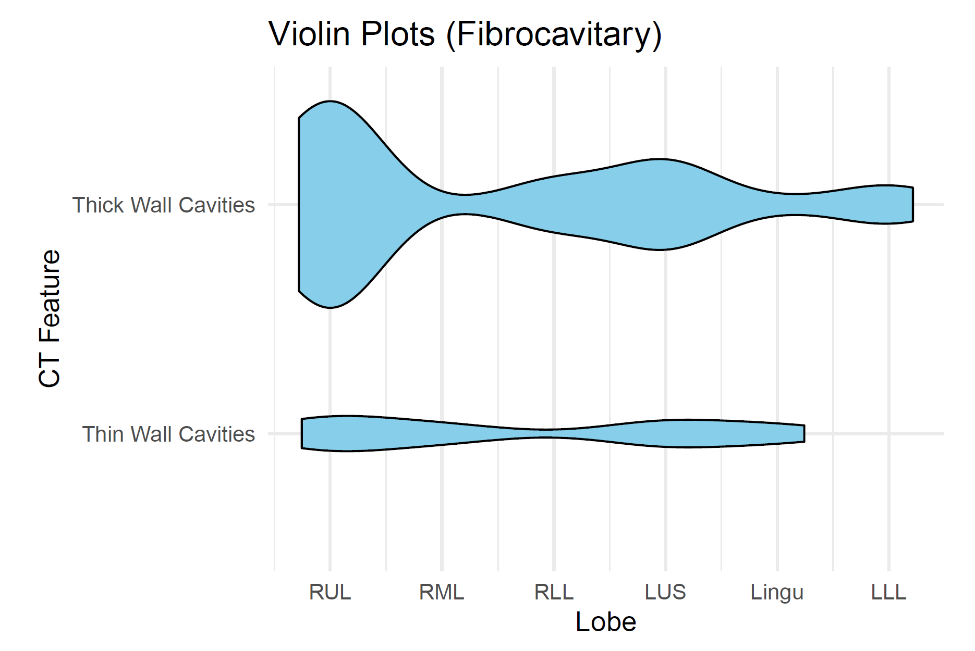
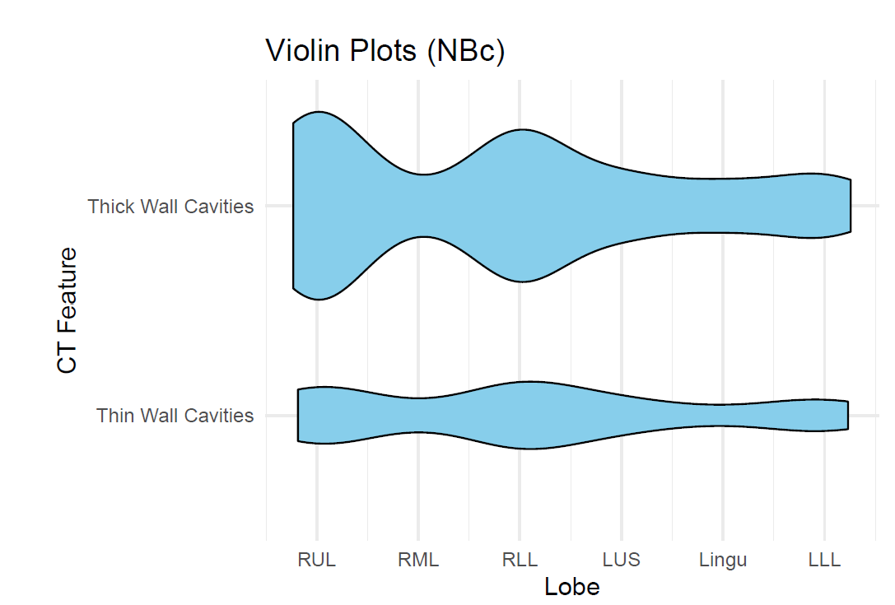
Table 2
 | Fibrocavitary disease (n=13)
Cavity | RUL | RML | RLL | LUS | Lingu | LLL
Thick-wall | 11 85% | 0 0% | 2.5 19% | 4.5 35% | 0.5 3.9% | 2 15%
Thin-wall | 2 15% | 1 8% | 0 0% | 1.5 12% | 1 7.7% | 0 0%
Nodular BXSIS with cavity (n=36)
RUL | RML | RLL | LUS | Lingu | LLL
16 44% | 2 6% | 13 35% | 4.5 13% | 3.5 10% | 5 14%
5.5 15% | 1 3% | 6 17% | 2.5 7% | 1 3% | 3 8%
All cavities: RUL, RLL, LUS > others (OR 2.340-58.29)
Fibrocavitary disease
Nodular BXSIS with cavity
Thick-wall
cavity
Thin-wall
cavity
RUL
RML
RLL
LUS
Lingu
LLL
RUL
RML
RLL
LUS
Lingu
LLL

Slide 4
Why are NTM (& TB) cavities more common in the upper lobes?
Decreased blood perfusion
Decreased lymphatic formation
Increased P_{A}O₂
Increased pH
Increased stiffness & mechanical stress on lung tissue
0.07
0
0
7.51
132
200
80
1.30
24
+++
7.39
Perfusion
(L/min)
P_{PA}
(mmHg)
89
30
10
Lymph
flow
pH
P_{A}O₂
(mmHg)
Stiffness (kPa)
Stress (kPa)
Decreased influx of immune cells, soluble mediators, & antibiotics
Decreased clearance
of NTM & antigens
Increased Warburg → decreased of both autophagy & killing of NTM
Increased aerobic growth of NTM
Increased risk of cavitation
Casha AR et al. J Infect Dis Epidemiol 2018
Shi L…Suki B. Scientific Rep 2022

Slide 5
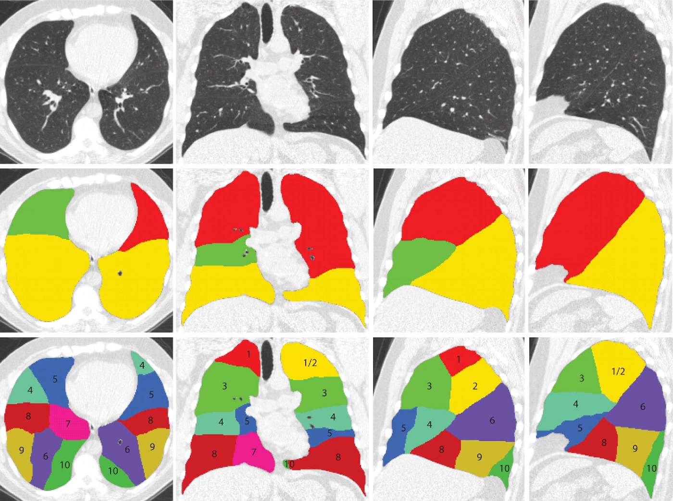
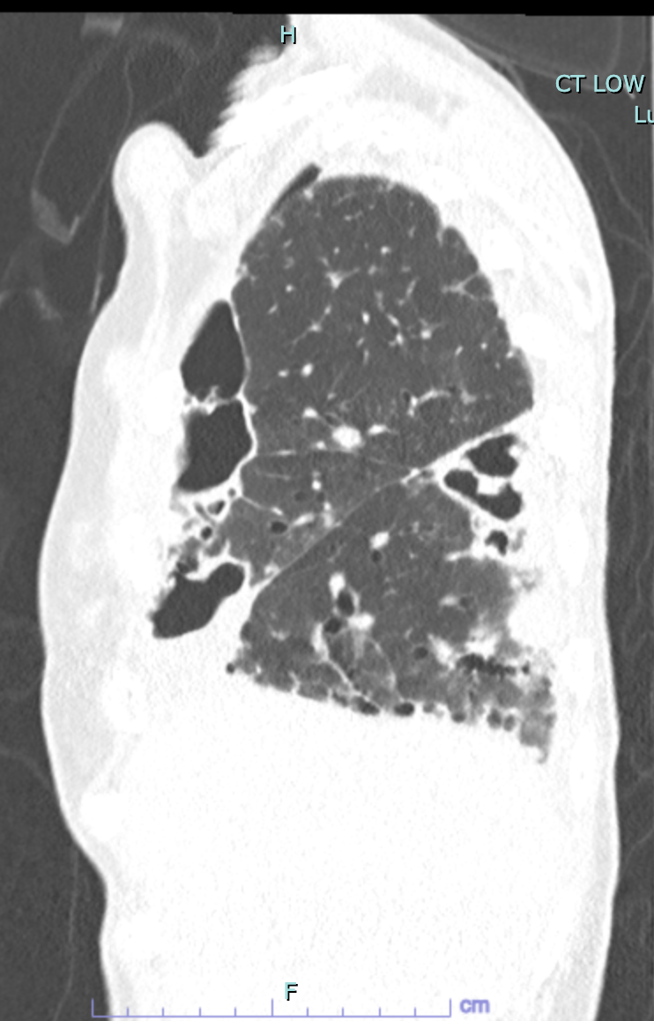
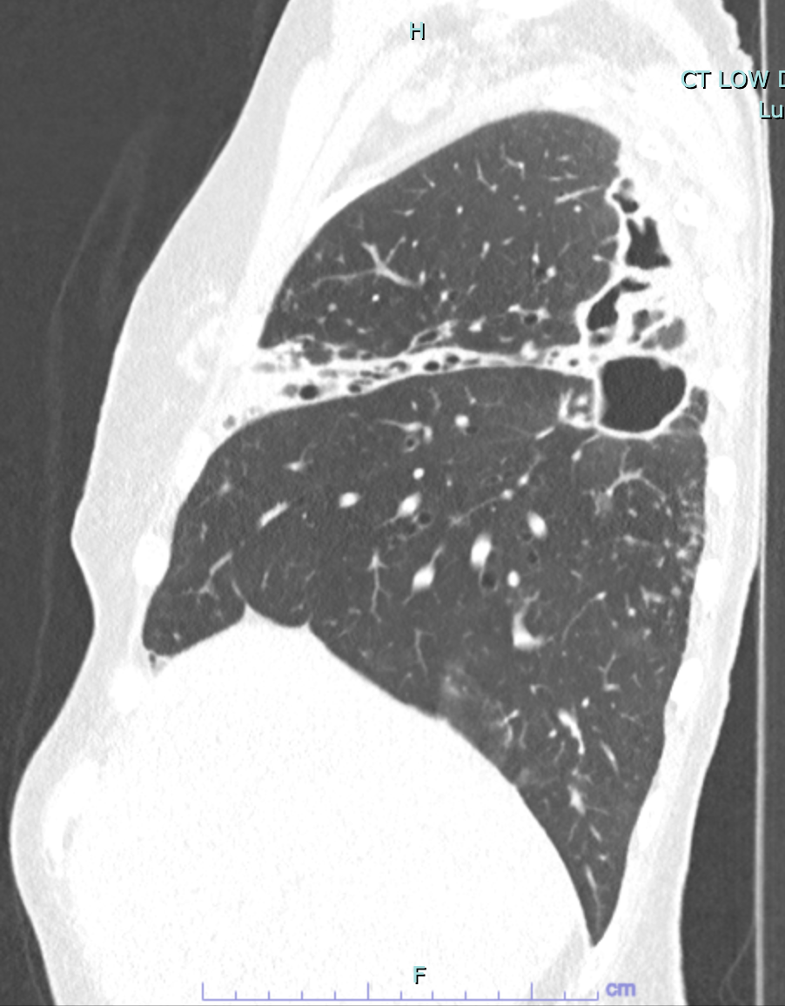
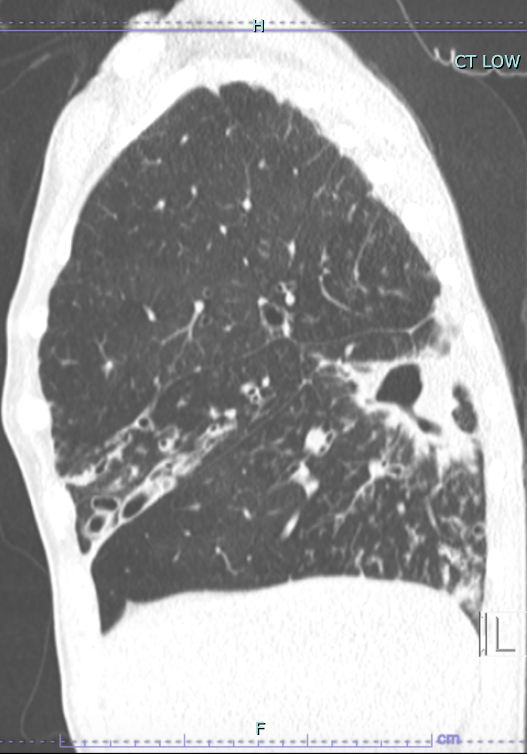
Patient #, CT Date | Cavity location in RLL
Patient 1, 8.15.2023 | Superior segment (SS)
Patient 2, 1.10.2023 | SS
Patient 3, 8.30.2023 | SS
Patient 4, 8.1.2023 | SS
Patient 5, 5.9.2023 | SS
Patient 6, 12.6.2023 | SS
Patient 7, 1.22.2024 | SS
Patient 8, 5.24.2023 | SS
Patient 9, 5.31.2023 | SS
Patient 10, 6.1.2023 | SS
Patient 11, 6.8.2023 | SS
Patient 12, 8.11.2023 | R posterior basal?
Patient 13, 6.15.2023 | R posterior basal?
Patient 14, 6.27.2018 | SS
Patient 15, 5.29.2024 | SS
Patient 16, 11.9.2017 | SS
Patient 17, 2.20.2024 | R posterior basal?
Patient 18, 4.7.2023 | SS
Patient 19, 3.24.2023 | SS
Patient 4
August 1, 2023
Patient 7
Jan 22, 2024
Patient 8
May 24, 2023

